Slide 1
ITM 352
HTML Forms,
Basic Javascript Form Processing

Slide 2
Some Inspiration!
Perseverance: never giving up
Indomitable Spirit: never wanting to give up
Formula for success
  Perseverance + Indomitable Spirit = Success
Indomitable Spirit
  “Get to your limit and see what’s on the other side” - Yoga
  "Try not. Do, or do not. There is no try." - Yoda
  “Suffering is optional” – Yoghurt
  “If you’re brain is hurting it just means you’re learning” – P²

Slide 3
What We Will Cover Today
Today we will explore HTML forms in some detail:
  Details on <FORM>
  Input types
  Compound types
  Some tips for HTML form elements

Slide 4
HTML Form Elements
A form element is a page object that enables input or output to the page.
Any input elements will have a value attribute
The most common input element looks like this:
<input type = '<type>'
name = '<the name of this element>'
value = '<the value of the input>'
>

Slide 5
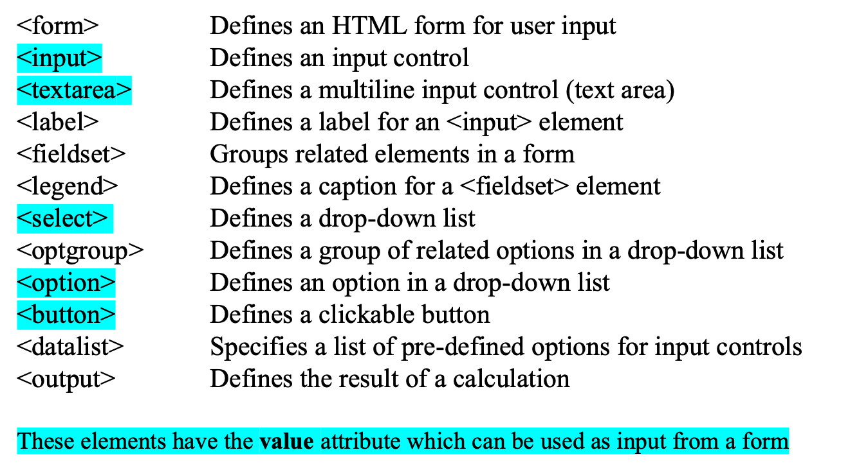
HTML Form Elements

Slide 6
HTML input types
Here are the HTML form element input types you can use
<input type="button">
<input type="checkbox">
<input type="color">
<input type="date">
<input type="datetime-local">
<input type="email">
<input type="file">
<input type="hidden">
<input type="image">
<input type="month">
<input type="number">
<input type="password">
<input type="radio">
<input type="range">
<input type="reset">
<input type="search">
<input type="submit">
<input type="tel">
<input type="text">
<input type="time">
<input type="url">
<input type="week">

Slide 7
Login
<head>
<meta charset="UTF-8">
<meta name="viewport" content="width=device-width, initial-scale=1.0">
<meta http-equiv="X-UA-Compatible" content="ie=edge">
<title>Document</title>
<script>
function checkLogin() {
passwords = {"dport":"spaz", "kazman":"geek"};
var username = document.getElementsByName("username_textbox")[0].value;
var password = document.getElementsByName("password_textbox")[0].value;
if(passwords[username] == password) {alert('logged in!');}
else {alert('incorrect login!');}
}
</script>
</head>
<body>
<label for="username">Username:</label><input type='text' name='username_textbox'>
<br>
<label for="password">Password:</label><input type='password' name='password_textbox'>
<br>
<input type='button' value='login' onclick="checkLogin();">
</body>
Do Lab #2

Slide 8
Form Parts
<form action = 'xxx' method = 'yyy’>
… <form elements> …
</form>
Used mainly to pass data to a server to access shared resources e.g. other web applications, files, data, operations, processing, etc.
  Browser can only access resources in the browser or from a server e.g. cannot load a file to generate an invoice from a file that enables users to select products. Everything would have to be done in
action is a URI to call on form submit
  If omitted or empty – current href
  ‘.’ – current href path, ‘..’ – parent of current path
method should be either POST or GET
  Determines the actions HTTP request of GET or POST
  If omitted or empty - GET

Slide 9
Action
An action is the form processor to use when the form is submitted
  Could by any URI (e.g. a protocol and path), usually a URL, e.g. http://www.somewebserver.com/myfile.html)
  Could be javascript: doThis();
  There are a variety of shorthand things e.g. 'myfile.html' is same as “current page’s document.location except myfile.html at end of path
Example if URL of current page is http://www.somewebserver.com/myfile.html
<form action = 'invoice.html'>
…
</form>
This will make an HHTP request to www.somewebserver.com with the path /invoice.html
The action only occurs when the form is submitted. This usually is done by adding a submit button to the form and the user presses it.
Note: You should always use quotes around the action in case it has special characters or spaces.

Slide 10
Method
The method can be either 'POST' or 'GET’.
  Data from the form will be packaged in the action as a GET or POST HTTP request
    The GET method will put the form data in a query string with the GET request
    POST method will put data in POST variables with the POST request
Must have a server process an HTTP request!
The npm Express package makes server processing a lot easier.

Slide 11
Submit Button
Usually you need to have a submit button to invoke a form's action, e.g.:
<input type = 'SUBMIT'
name = 'the name you want to appear in the POST/GET array'
value = 'the label in the button '
>

Slide 12
Example: Login
<form action ='invoice.php' method = 'POST'>
<input type = 'SUBMIT' name = 'submit_button' value = 'Login'>
</form>
Do Lab #1

Slide 13
Self-Processing Form
Sometimes you want to stay on the same page when processing your forms
<form action = '<?= $_SERVER["PHP_SELF"]?>' method = 'post'>
</form>
is the same as:
<form action = '<?php $_SERVER["PHP_SELF"] ?>'method = 'post'>
</form>
<?= is short for echo when embedding PHP in HTML
You can use $PHP_SELF or $_SERVER['PHP_SELF']

Slide 14
Login
if( array_key_exists('submit_button', $_POST) ) {
print "logged in " . $_POST['username'];
}
else {
?>
<form action = '<?php $_SERVER['PHP_SELF'] ?>' method = 'post'>
<input type = 'text' name = 'username'>
<input type = 'password' name = 'password'>
<input type = 'submit' name = 'submit_button' value = 'login'>
</form>
<?php } ?>
Do Lab #3

Slide 15
GET method
<form method = 'get'> … </form>
GET will show the information being passed between pages as part of the URL.
  Good tool for error checking
  However, it is not secure because users can see the full contents of the request.
  Pages can be cached.

Slide 16
POST method
<form method = 'post'> … </form>
POST will hide information being passed between pages in the address bar.
  HINT: use GET for error checking; change to POST when submitting your work
  More secure than GET
  Pages won't be cached.
Do Lab #4

Slide 17
Compound Types
Select
Text area
List box
Compound types enable multiple inputs and/or outputs
Unlike input types, compound types always use a begin and end tag
  <select name='a_select_box'> … </select>

Slide 18
Login
if( array_key_exists('submit_button', $_POST) ) {
print "logged in " . $_POST['username'];
}
else {
?>
<form action = '<?php $_SERVER['PHP_SELF'] ?>'
method = 'post'>
<select name='username'>
<option>Moe</option>
<option>Larry</option>
<option>Curly</option>
</select>
<input type = 'password' name = 'password'>
<input type = 'submit' name = 'submit_button'
value = 'login'>
</form>
<?php } ?>

Slide 19
Select Boxes
Select boxes provide a drop down set of options for the user to choose from.
  Value is whatever the user chooses when the submit button is pressed
  If no value parameter is set, the value defaults to the label
<SELECT name="a_select_box">
<OPTION value="value_of_thing1">thing1</OPTION>
<OPTION value="value_of_thing2">thing2</OPTION>
<OPTION value="value_of_thing3">thing3</OPTION>
</SELECT>

Slide 20
Text Area
Text Area provide a region of size row X cols to display and input text.
  Value is whatever is in the area when the submit button is pressed
<TEXTAREA name="a_test_area" rows="20" cols="40">
This is some text in the text area.
</TEXTAREA>

Slide 21
Tips and Hints
Use single ' ' on the inside, " " around the outside or vice versa
Take advantage of PHP by using for/while/foreach to generate multiple form elements and compound types
Quotes must be used around anything with spaces
Do Extra Credit (optional)

Slide 22
Pass Data No Server
example_pass.html
<script>
function passThis() {
queryStr = '?';
formElts = document.forms[0].elements;
for(i=0; i< formElts.length; i++) {
queryStr += `${formElts[i].name}=${formElts[i].value}&`;
}
window.location.href = "file:test.html" + queryStr;
}
</script>
<body>
<form action="javascript:passThis();">
<input type='text' name='login_textbox'>
<br>
<input type='SUBMIT' name='submit_button' value='Login'>
</form>
</body>
test.html
<script>
// get the data in the query string and put into GET object
let params = (new URL(document.location)).searchParams;
GET = {};
params.forEach(function (value, key) { GET[key] = value });
for (thing in GET) {
document.write(`${thing} is ${GET[thing]}<br>`);
}
</script>

Slide 23
Login: Pass Data No Server
example_pass.html
<script>
function passThis() {
queryStr = '?';
formElts = document.forms[0].elements;
for(i=0; i< formElts.length; i++) {
queryStr += `${formElts[i].name}=${formElts[i].value}&`;
}
window.location.href = "file:test.html" + queryStr;
}
</script>
<body>
<form action="javascript:passThis();">
<input type='text' name='login_textbox'>
<br>
<input type='SUBMIT' name='submit_button' value='Login'>
</form>
</body>
test.html
<script>
// get the data in the query string and put into GET object
let params = (new URL(document.location)).searchParams;
GET = {};
params.forEach(function (value, key) { GET[key] = value });
for (thing in GET) {
document.write(`${thing} is ${GET[thing]}<br>`);
}
</script>

Slide 24
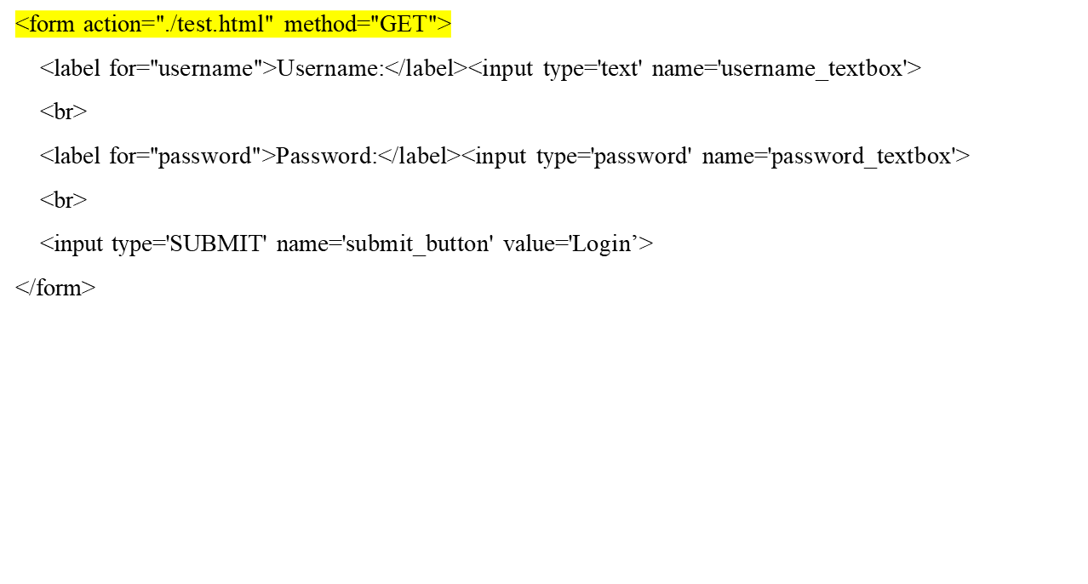
Pass Data With Server, no processing - GET

Slide 25
Processing On Sever (POST or GET)
info_process_server.js must run on server with Node.js
var express = require('express');
var myParser = require("body-parser");
var fs = require('fs');
var app = express();
app.use(myParser.urlencoded({ extended: true }));
app.post("/process_login", function (request, response) {
// response.send(request.body);
let POST = request.body;
var contents = fs.readFileSync('./Views/display_login_template.html', 'utf8');
response.send(eval('`' + contents + '`')); // render template string
});
app.use(express.static('.'));
app.listen(8080);
./Views/display_name_template.html
<body>
<div style="text-align:center">
<img src="./Images/cool.jpg" height="100px" width="100px">
<br>
Nice to meet you ${POST["firstname"]} ${POST["lastname"]}
</div>
</body>

